Slide 1
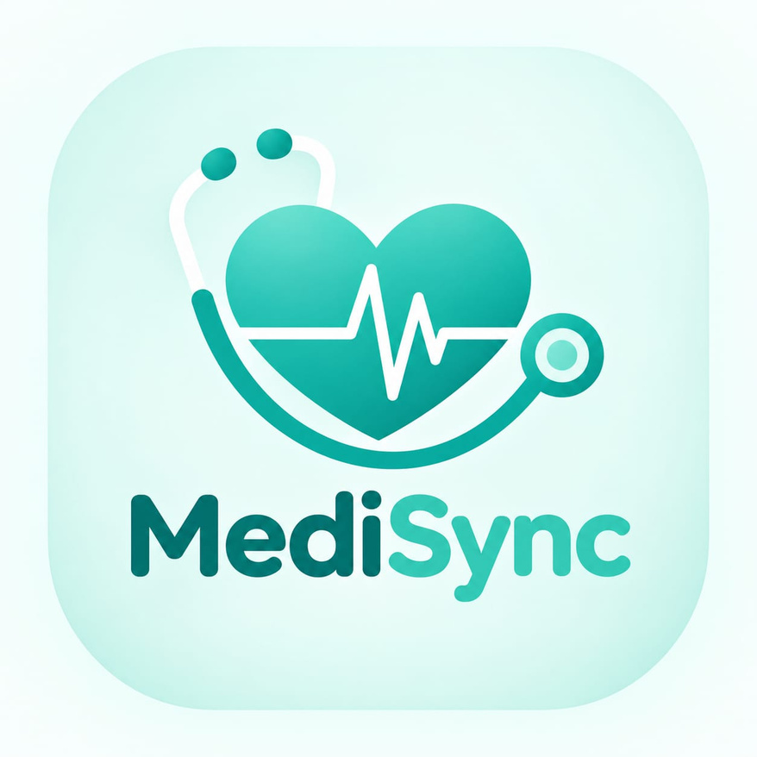
MediSync
A Medical Health Record , Reminder and Resolver
Management Application
Presentation By:
AGNEL 2605 • AMLISHA 2608 • VAISHNAVI 2666
01 / 18

Slide 2
One place for everyday health information
MediSync centralizes personal medical records, prescriptions and reminders in a simple mobile experience.
01
02
03
RECORD
REMIND
RESOLVE
Organize reports and prescriptions for quick retrieval.
Keep daily healthcare schedules visible and actionable.
Access implemented healthcare-related functions in one module.
02 / 18

Slide 3
Fragmented records create avoidable friction
01
02
03
04
05
Scattered
documents
Loss or
damage
Slow
retrieval
Missed
medication
Broken medical
history
MEDISYNC • MCA PROJECT
03 / 18

Slide 4
Five objectives, one coherent experience
The project focuses on organization, access, reminders, retrieval and usability.
1
Digitally organize personal medical data
2
Simplify access to records and prescriptions
3
Provide personalized healthcare reminders
4
Improve retrieval and management
5
Deliver a user-friendly mobile experience
MEDISYNC • MCA PROJECT
04 / 18

Slide 5
From paper trails to structured access
Traditional handling introduces gaps that a centralized mobile workflow can reduce.
TRADITIONAL
MEDISYNC DIRECTION
Dispersed & manual
Centralized & accessible
Paper documents
Unorganized information
Manual retrieval
No automated reminders
Incomplete continuity
Digital organization
Module-based navigation
Faster retrieval
Reminder support
Continuous personal history
MEDISYNC • MCA PROJECT
05 / 18

Slide 6
MediSync integrates three focused modules
A mobile interface connects healthcare information, reminders and implemented assistance functions.
RECORD
Medical documents
REMIND
Schedules & alerts
RESOLVE
Implemented functions
Shared navigation • coordinated data flow • consistent mobile experience
MEDISYNC • MCA PROJECT
06 / 18

Slide 7
Core capabilities
A concise feature set designed around personal healthcare organization.
Medical record
management
Prescription
organization
Personalized
reminders
Module-based
navigation
Conceptual secure
data handling
Efficient
retrieval
MEDISYNC • MCA PROJECT
07 / 18

Slide 8

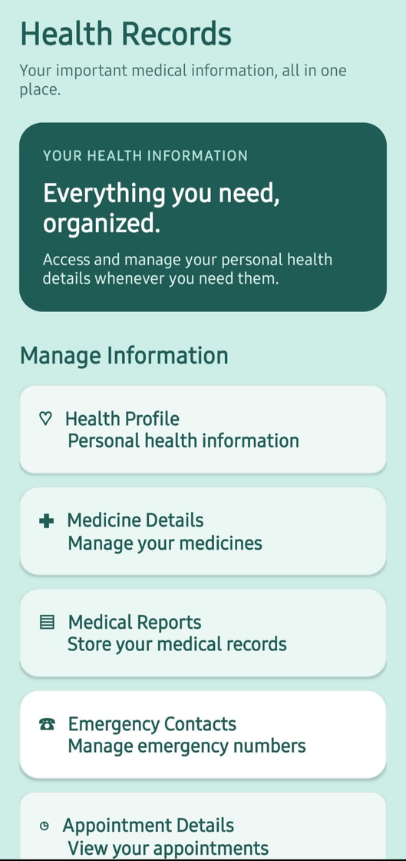
Record: organize and retrieve
A dedicated module for personal medical documents and prescriptions.
• Store medical documents digitally
• Organize prescriptions for access
• Retrieve previously saved records
• Categorize records where supported
• Simplify document interaction
MEDISYNC • MCA PROJECT
08 / 18

Slide 9
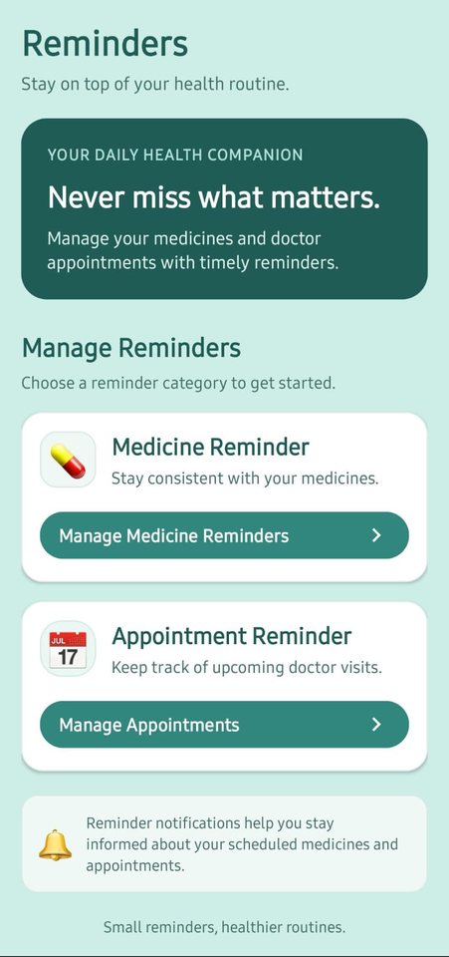
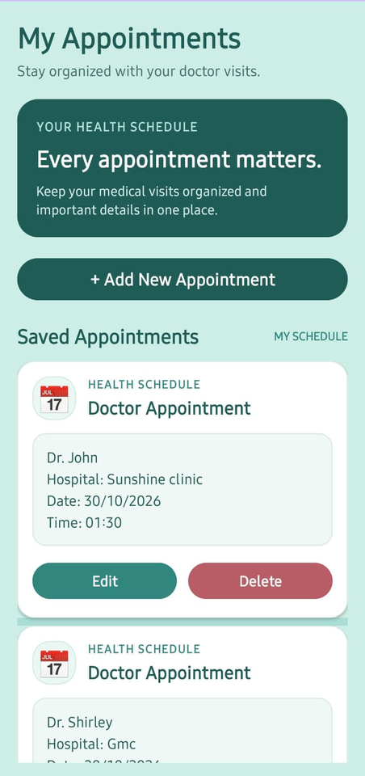
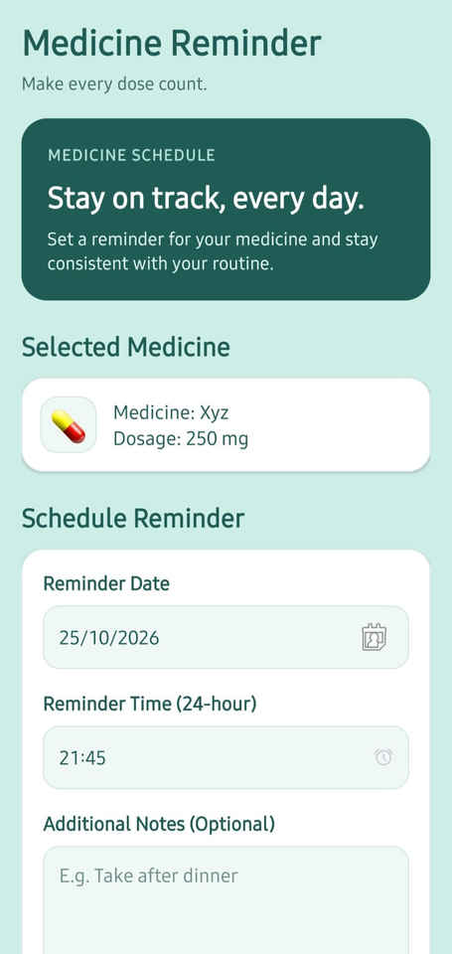
Remind: make schedules visible
Create, personalize and manage reminders with date/time settings where supported.
Reminders
Appointments
Medicine Reminder
09 / 18

Slide 10
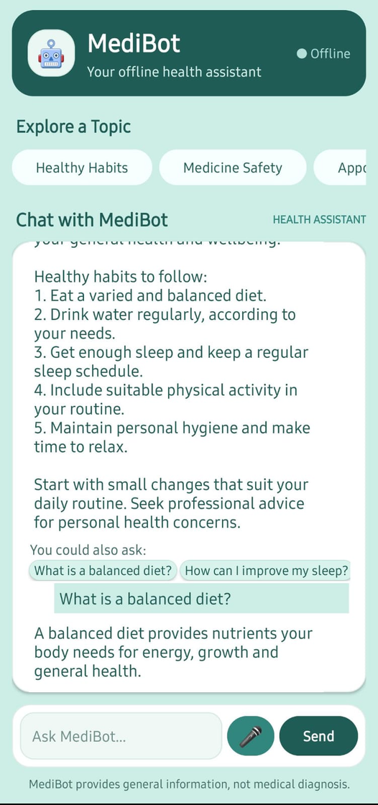
Resolve: scoped to verified implementation
Healthcare-related functions
implemented in the app
The Resolve module in MediSync is designed to help users address their healthcare-related needs by providing access to relevant medical information and assistance features.
MEDISYNC • MCA PROJECT
10 / 18

Slide 11
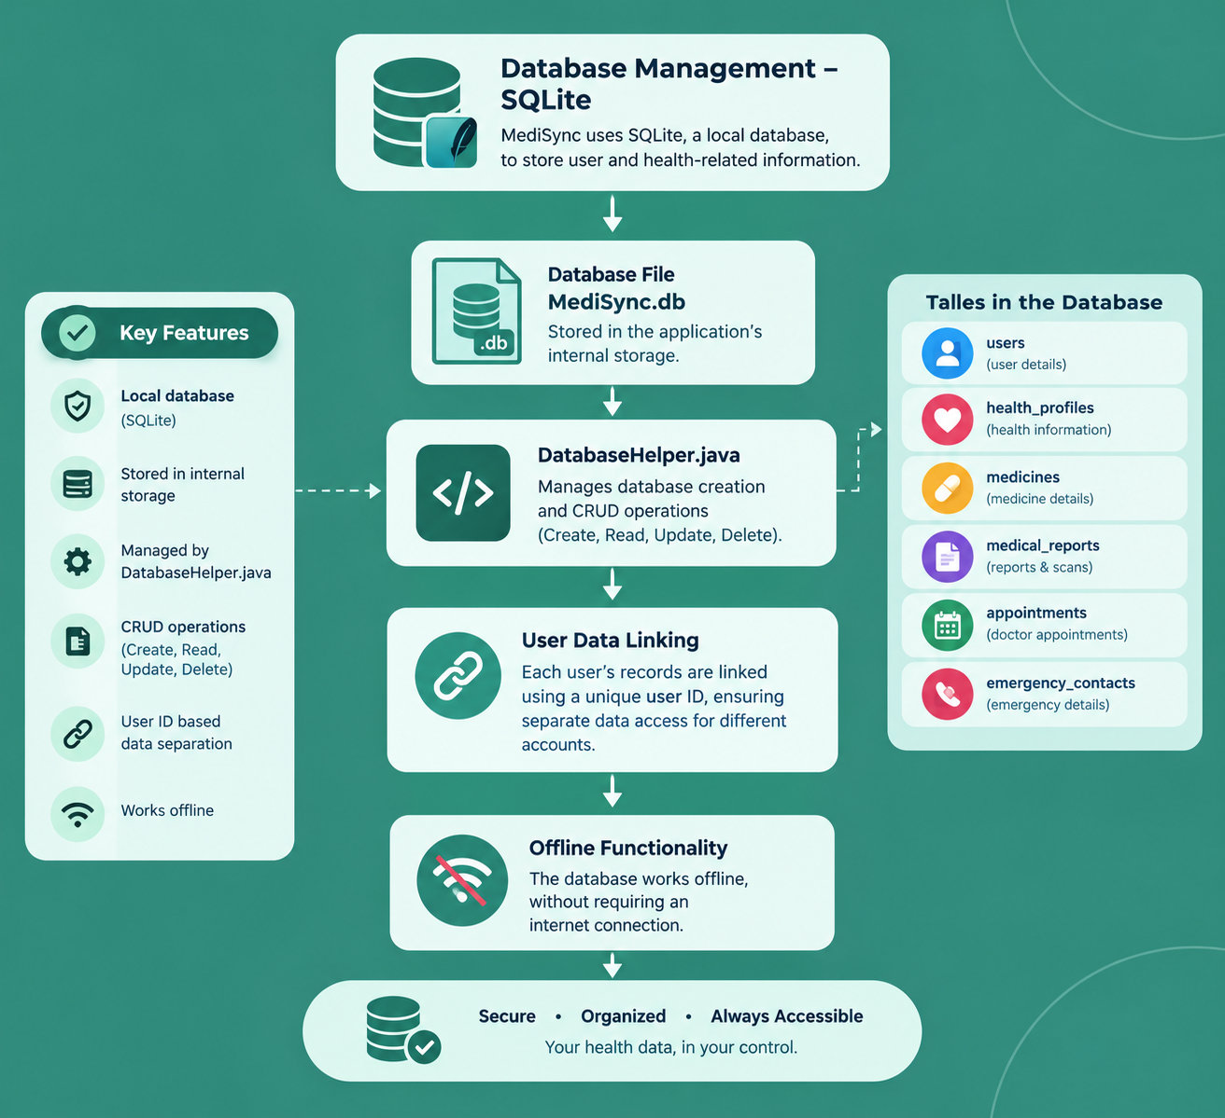
Proposed database design
MEDISYNC • MCA PROJECT
13 / 18

Slide 12
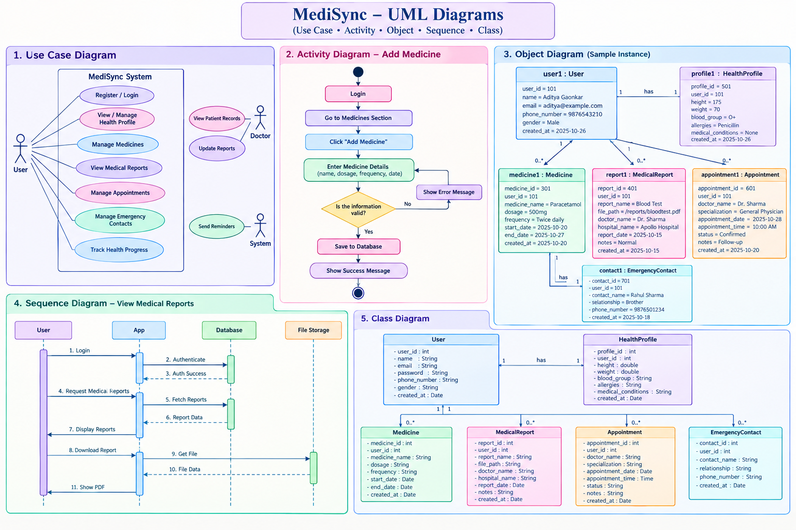

Slide 13
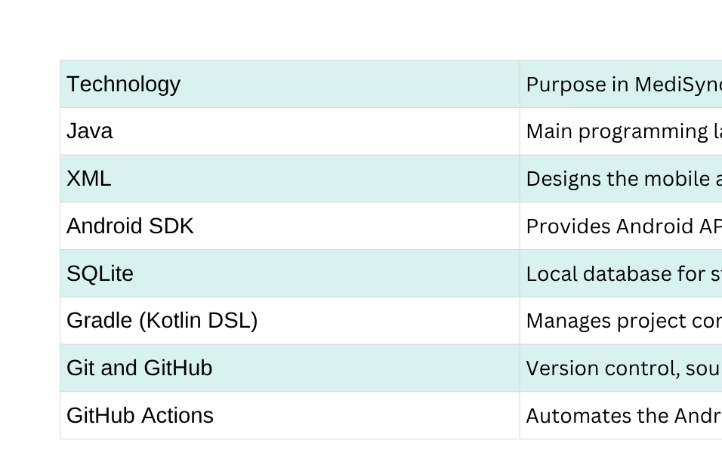
Technology stack
Editable fields — complete only with technologies verified in the final implementation.
MEDISYNC • MCA PROJECT
15 / 18

Slide 14
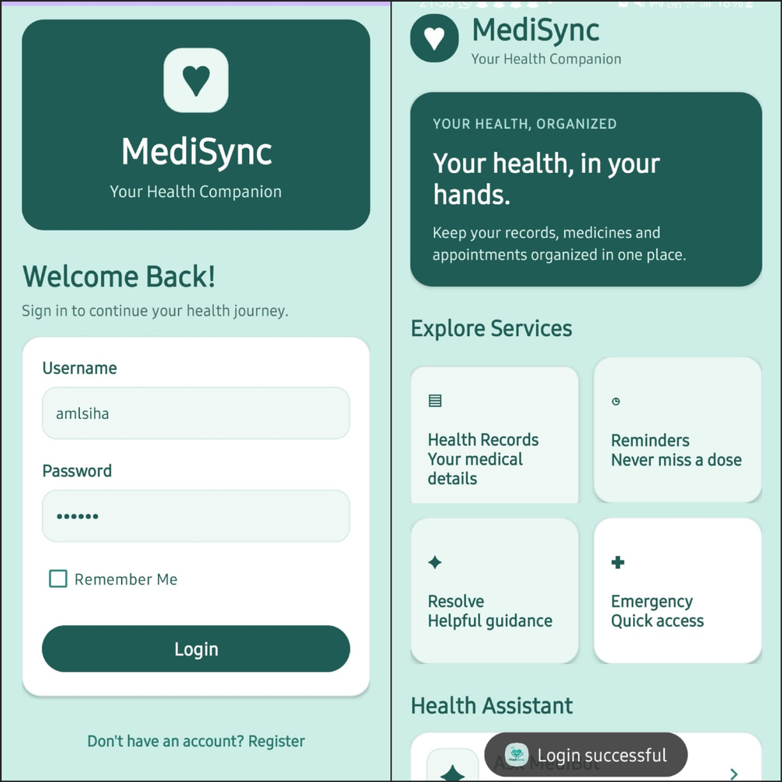
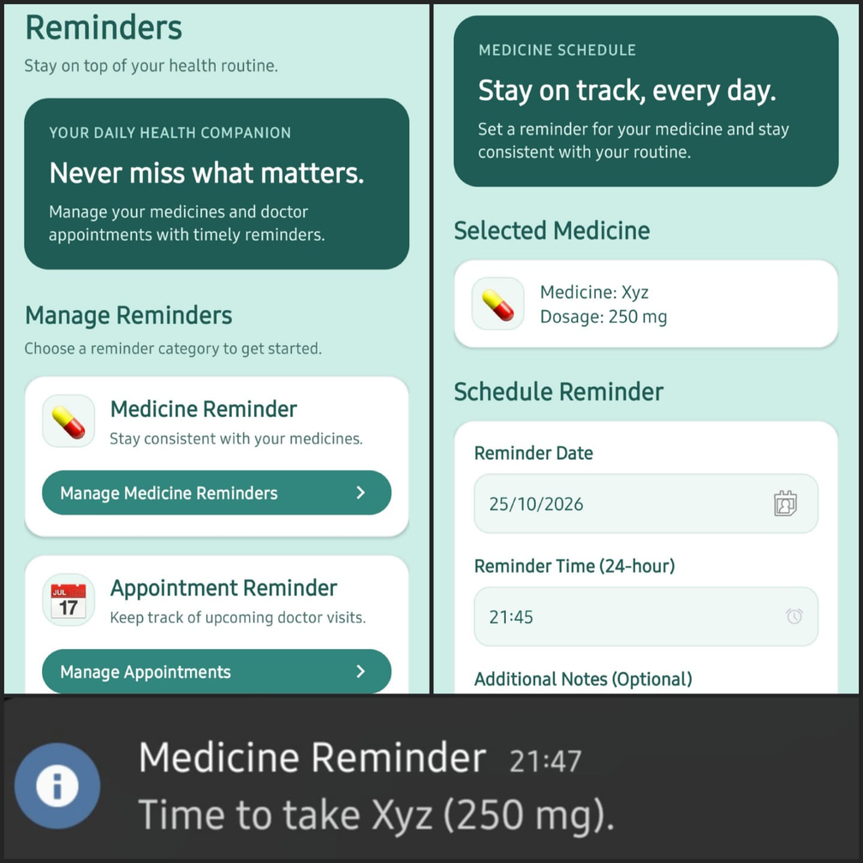
Testing & results
MEDISYNC • MCA PROJECT
17 / 18

Slide 15
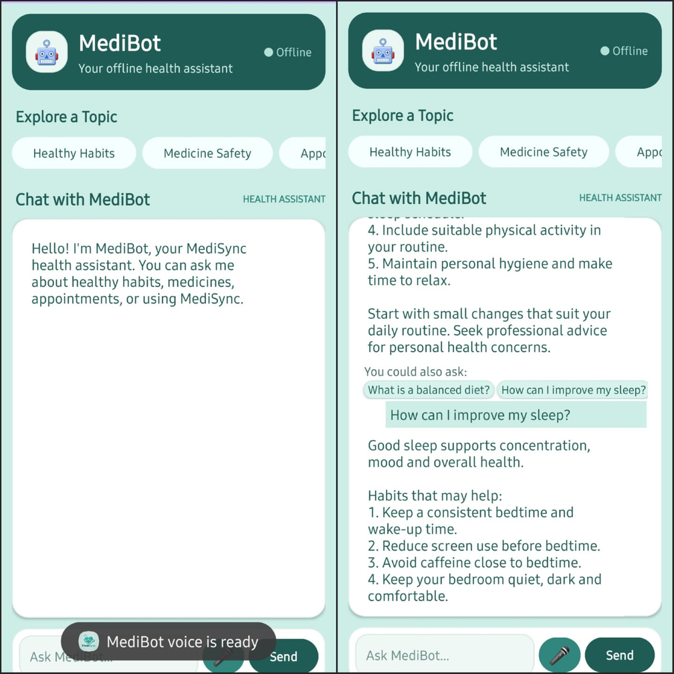
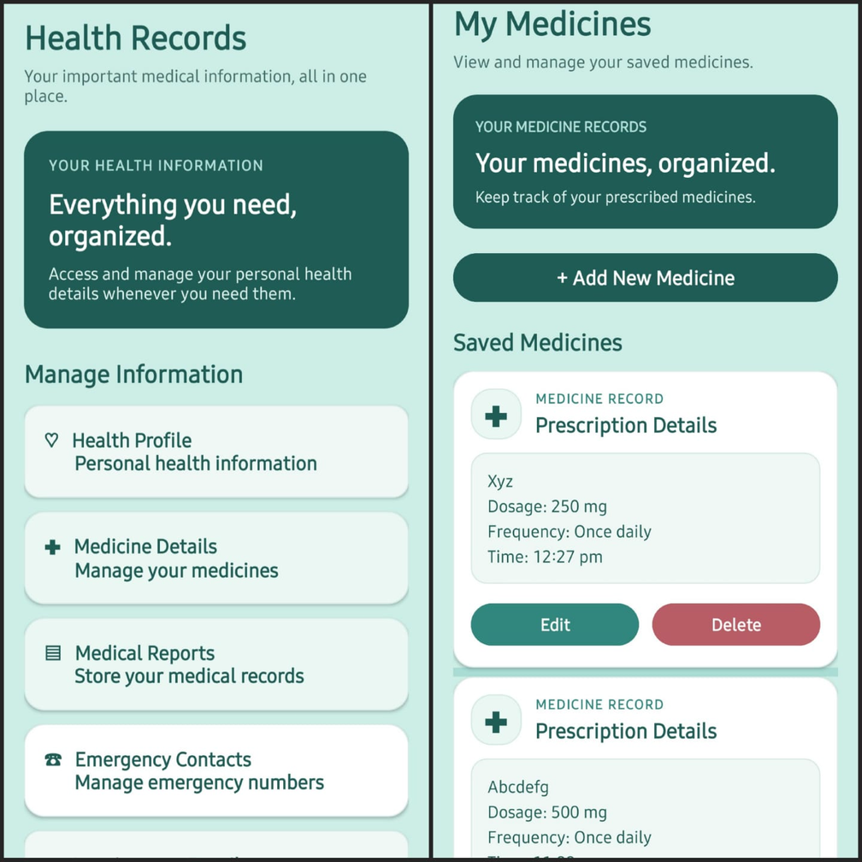
Testing & results
MEDISYNC • MCA PROJECT
17 / 18

Slide 16
A clearer way to manage personal health information
MediSync brings records, reminders and implemented healthcare functions into one coordinated mobile experience.
CONCLUSION
FUTURE SCOPE
MediSync simplifies healthcare management by organizing medical records, medicines, appointments, and emergency contacts in one place. Using Java, XML, and SQLite, it provides an efficient way to manage health information and supports better healthcare organization and accessibility.
MediSync can be enhanced with secure cloud storage, online doctor consultations, electronic prescriptions, and integration with wearable health devices. Future updates may include AI-based health insights, automatic medicine reminders, and emergency alerts to make healthcare management more efficient and accessible.
MEDISYNC • MCA PROJECT
18 / 18

Slide 17
THANK YOU.
QUESTIONS?
MEDISYNC • MCA PROJECT
18 / 18

